Slide 1
CSE 12: Week 1 Discussion
Focus: PA 1, Logistics, JUnit, interface

Slide 2
About me
Qiyue (Cheery) Wang
BS in Computer Science from UCSD
First year Master student
Email: qiw131@ucsd.edu
Tutor hour: Wed 1 - 2 pm PST (subject to change)

Slide 3
What will Discussion cover?
Introduction to the Programming Assignment due next week (every Wednesday at 11:59 pm PST)
What you are asked to do
Related CS concepts
Answers to course related questions (if you have any)

Slide 4
How to look for PA help?
Course slides/code, discussion slides/recording
Slides can be found in schedule from course website
Optional ZyBook
Tutor hours
Professor office hours (more focused on general concepts than debugging)

Slide 5
Poll: Have you gone to tutor hours before?
I have gone to CSE 12 tutor hours
I have only gone to tutor hours for other CSE courses at UCSD
I have never gone to tutor hours for any CSE course

Slide 6
How to use tutor hours?
Instructions on course website
Go to Autograder
Login with UCSD SSO credentials (@ucsd.edu email and MyTritonlink password)
Create ticket and wait for help

Slide 7
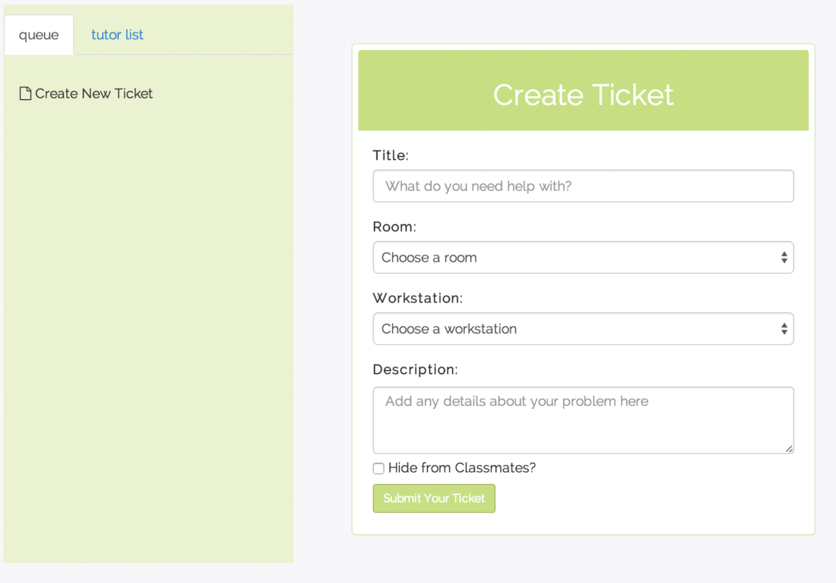
Doesn’t matter since we are remote now
Try to be descriptive. E.g. NullPointerException in Test.java

Slide 8
What’s expected from YOU in tutoring
Enter tutor’s zoom room as soon as your ticket is accepted and the link is posted
If you do not enter the zoom room in two minutes after the link is posted, your ticket will be skipped, and the next available tutor will accept your ticket
If you are already skipped once, and you do not join the zoom room in time again, your ticket will be cancelled
Only ask one question for each ticket
If you have more than one question, you can always create another ticket right after your previous question is resolved
Try debugging by yourself first (e.g. print statements, debugger, etc.) before asking for help
5-minute rule: Tutors only help you unstuck. They are not expected to solve the problem for you!

Slide 9
PA1: Testing Shopping Baskets

Slide 10
Overview
https://github.com/CSE12-SP21-Assignments/cse12-sp21-pa1-Testing
You are working for a Web shopping company where you need to create shopping cart functionality to keep track of items before a customer checks out.
You are given 13 different implementations of Basket
Your job is to write JUnit tests to cover the potential issues that might occur in the implementations
Note: All of your code will be written in BasketTest.java. DO NOT change any other file

Slide 11
Overview
Part 1
Write your tests for the Basket implementations
Submit BasketTest.java to “Programming Assignment 1 - code” on Gradescope
Part 2
Answer the questions in the write up on the Gradescope assignment “Programming Assignment 1 - questions”

Slide 12
Grading
For this assignment, your code’s grade is dependent on the number of Basket implementations you successfully distinguished by unit tests.
Example 1: 3 Basket implementations distinguished
 | addOneItem() | addDiffItems()
Basket1 | Success | Success
Basket2 | Success | Failure
Basket3 | Failure | Success

Slide 13
Grading
Example 2: 2 Basket implementation distinguished
Note: In this assignment, an exception (red cross on Eclipse) is ok for distinguishing implementations. However, in general, we don’t want exceptions to count as failure, only for this PA
 | addOneItem() | addDiffItems()
Basket1 | Failure | Success
Basket2 | Success | Success
Basket3 | Failure | Success

Slide 14
Grading
For this assignment, style will not be graded
For future assignments, style WILL BE graded
Style requirements for future assignments
Try to keep each line of code fewer than 100 characters
Consistent indentation
Meaningful/Descriptive names for methods and tests
Examples of not meaningful names: test1, method1

Slide 15
Practice: How to write unit tests
Given a class Student with the method addCourse that adds a Course to a student’s course list, courses.
What are some unit tests we can create to make sure any given implementation is correct?

Slide 16
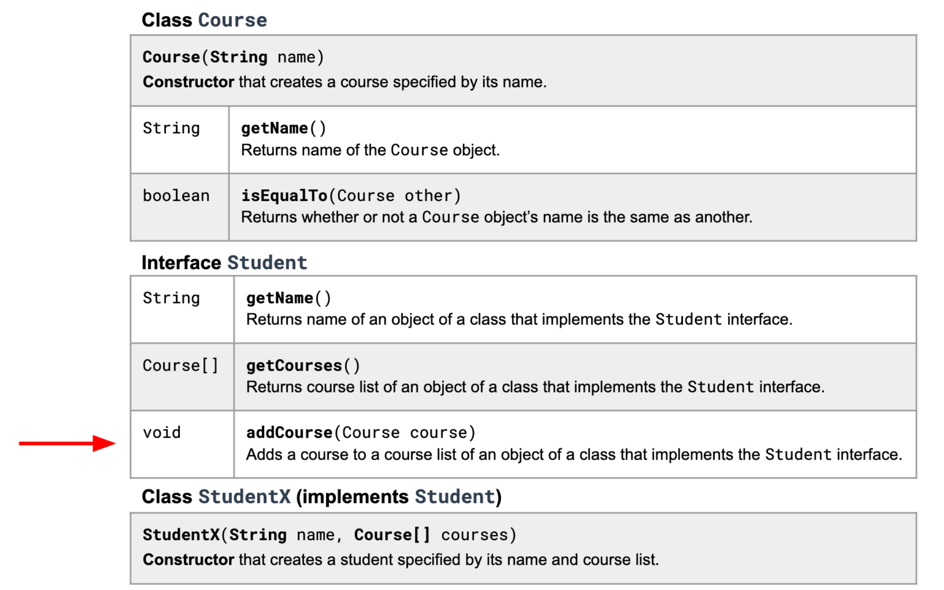

Slide 17
What are some test ideas for addCourse?
Make sure list contains the added course after
Make sure list length increases by 1
Test capacity bounds
Doesn’t affect previous information
Check for duplicates
Make sure added course is actually a course

Slide 18
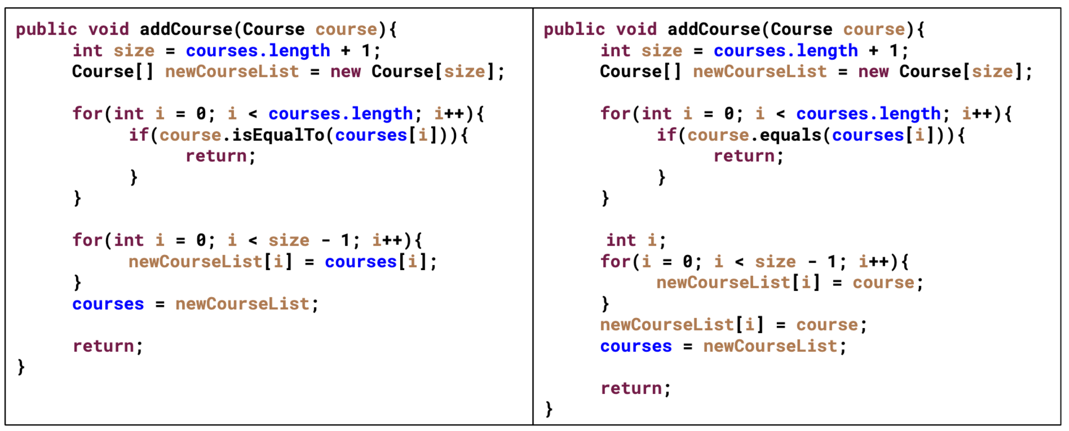
2 implementations of addCourse
Missing adding course to newCourseList
Are there any more tests we should add?

Slide 19
Source code - JUnit testing example
Given 3 versions of the Student interface in classes StudentA, StudentB, and StudentC, we can implement unit tests to check for functionality. These will be added to the StudentTest class (similar to BasketTest class in PA1).
Note: All code will be posted as well as a skeleton version of StudentTest so that you can try writing your own

Slide 20
Additional Resource
Review worksheet for Java interface:
Interface worksheet
Interface worksheet solution

Slide 21
Questions?

Slide 22
Debugging

Slide 23
Types of Errors
Compile Errors
Runtime Errors
Logic Errors

Slide 24
Compiler Errors
Syntax Error
Error in usage of Java
Detected by the compiler
A program with compilation errors cannot be run
Syntax Warning
Warning message generated by the compiler
The program can be run

Slide 25
Compiler Errors
Very common (but sometimes hard to understand). Examples of syntax errors:
Forgetting a semicolon
Leaving out a closing bracket }
Re-declaring a variable
Others?
Hint to help find/fix compiler errors
Compiler errors are cumulative: when you fix one, others may go away
Read the error messages issued by the compiler!

Slide 26
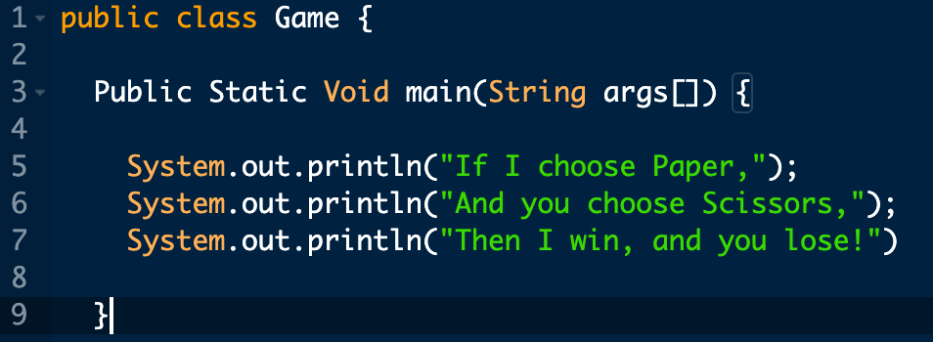
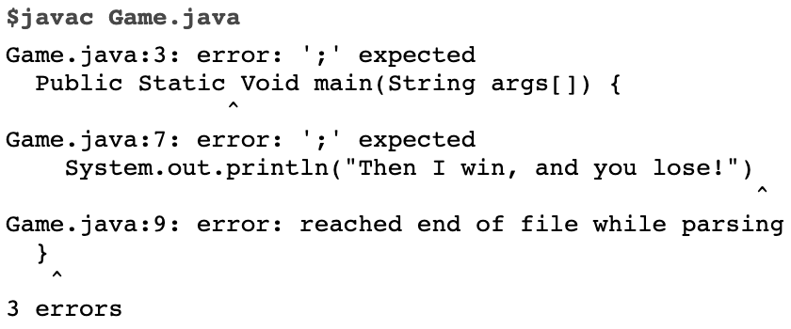

Slide 27
Runtime Errors
Runtime Error: program runs but gets an exception error message
Program may be terminated
Very common runtime errors are:
Null reference (NullPointerException)
No object is referenced by the reference variable, i.e. it has the value null
Array index out of bounds (ArrayIndexOutOfBoundsException)
Running out of memory
From creating a new object every time through an infinite loop

Slide 28
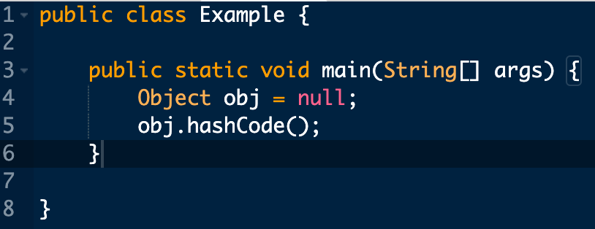

Slide 29
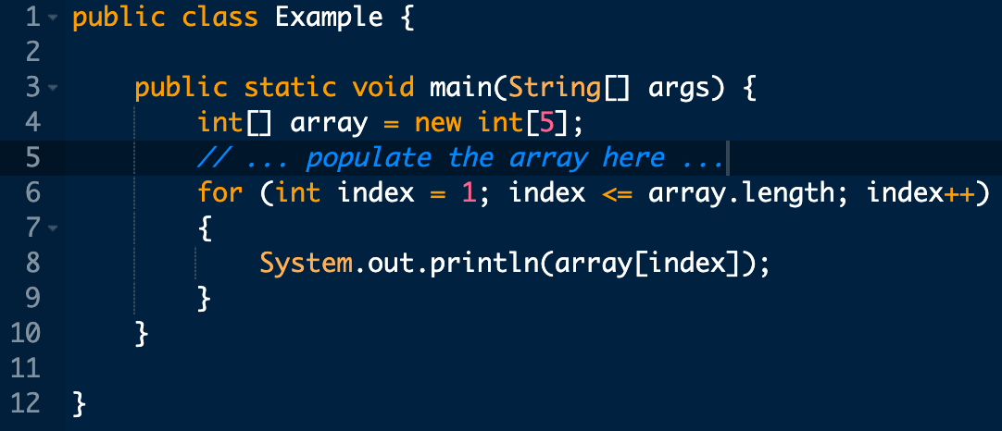
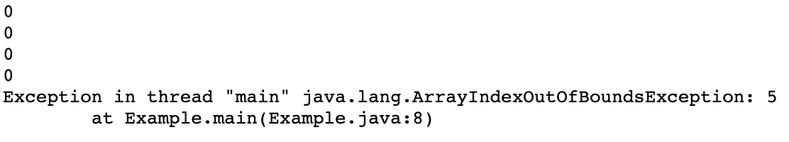

Slide 30
Logic Errors
Programs run but results are not correct
Caused by incorrect algorithm
Very common logic errors are:
Using == instead of equals method
Infinite loop
Misunderstanding of operator precedence
Starting or ending at the wrong index of an array
Misplaced parenthesis
Keep in mind the scope of the variables! (instance variables, formal parameters, local variables)

Slide 31
Debugging Strategies
Trace your code by hand
Put print statements to inspect variable values or use the debugger in your IDE

Slide 32
Questions?

